Slide 1
Chest X-Ray Covid-19 Detection using CNN
PRESENTED BY :
S.THEJASWINI
513121104044
THANTHAI PERIYAR GOVERNMENT INSTITUTE OF TECHNOLOGY-VELLORE

Slide 2
Project title
Chest X-Ray Covid-19 Detection using CNN

Slide 3
Agenda
Problem Statement
Project Overview
End Users
Our Solution and Proposition
The Wow in the Solution
Modeling
Results and Evaluation
Conclusion

Slide 4
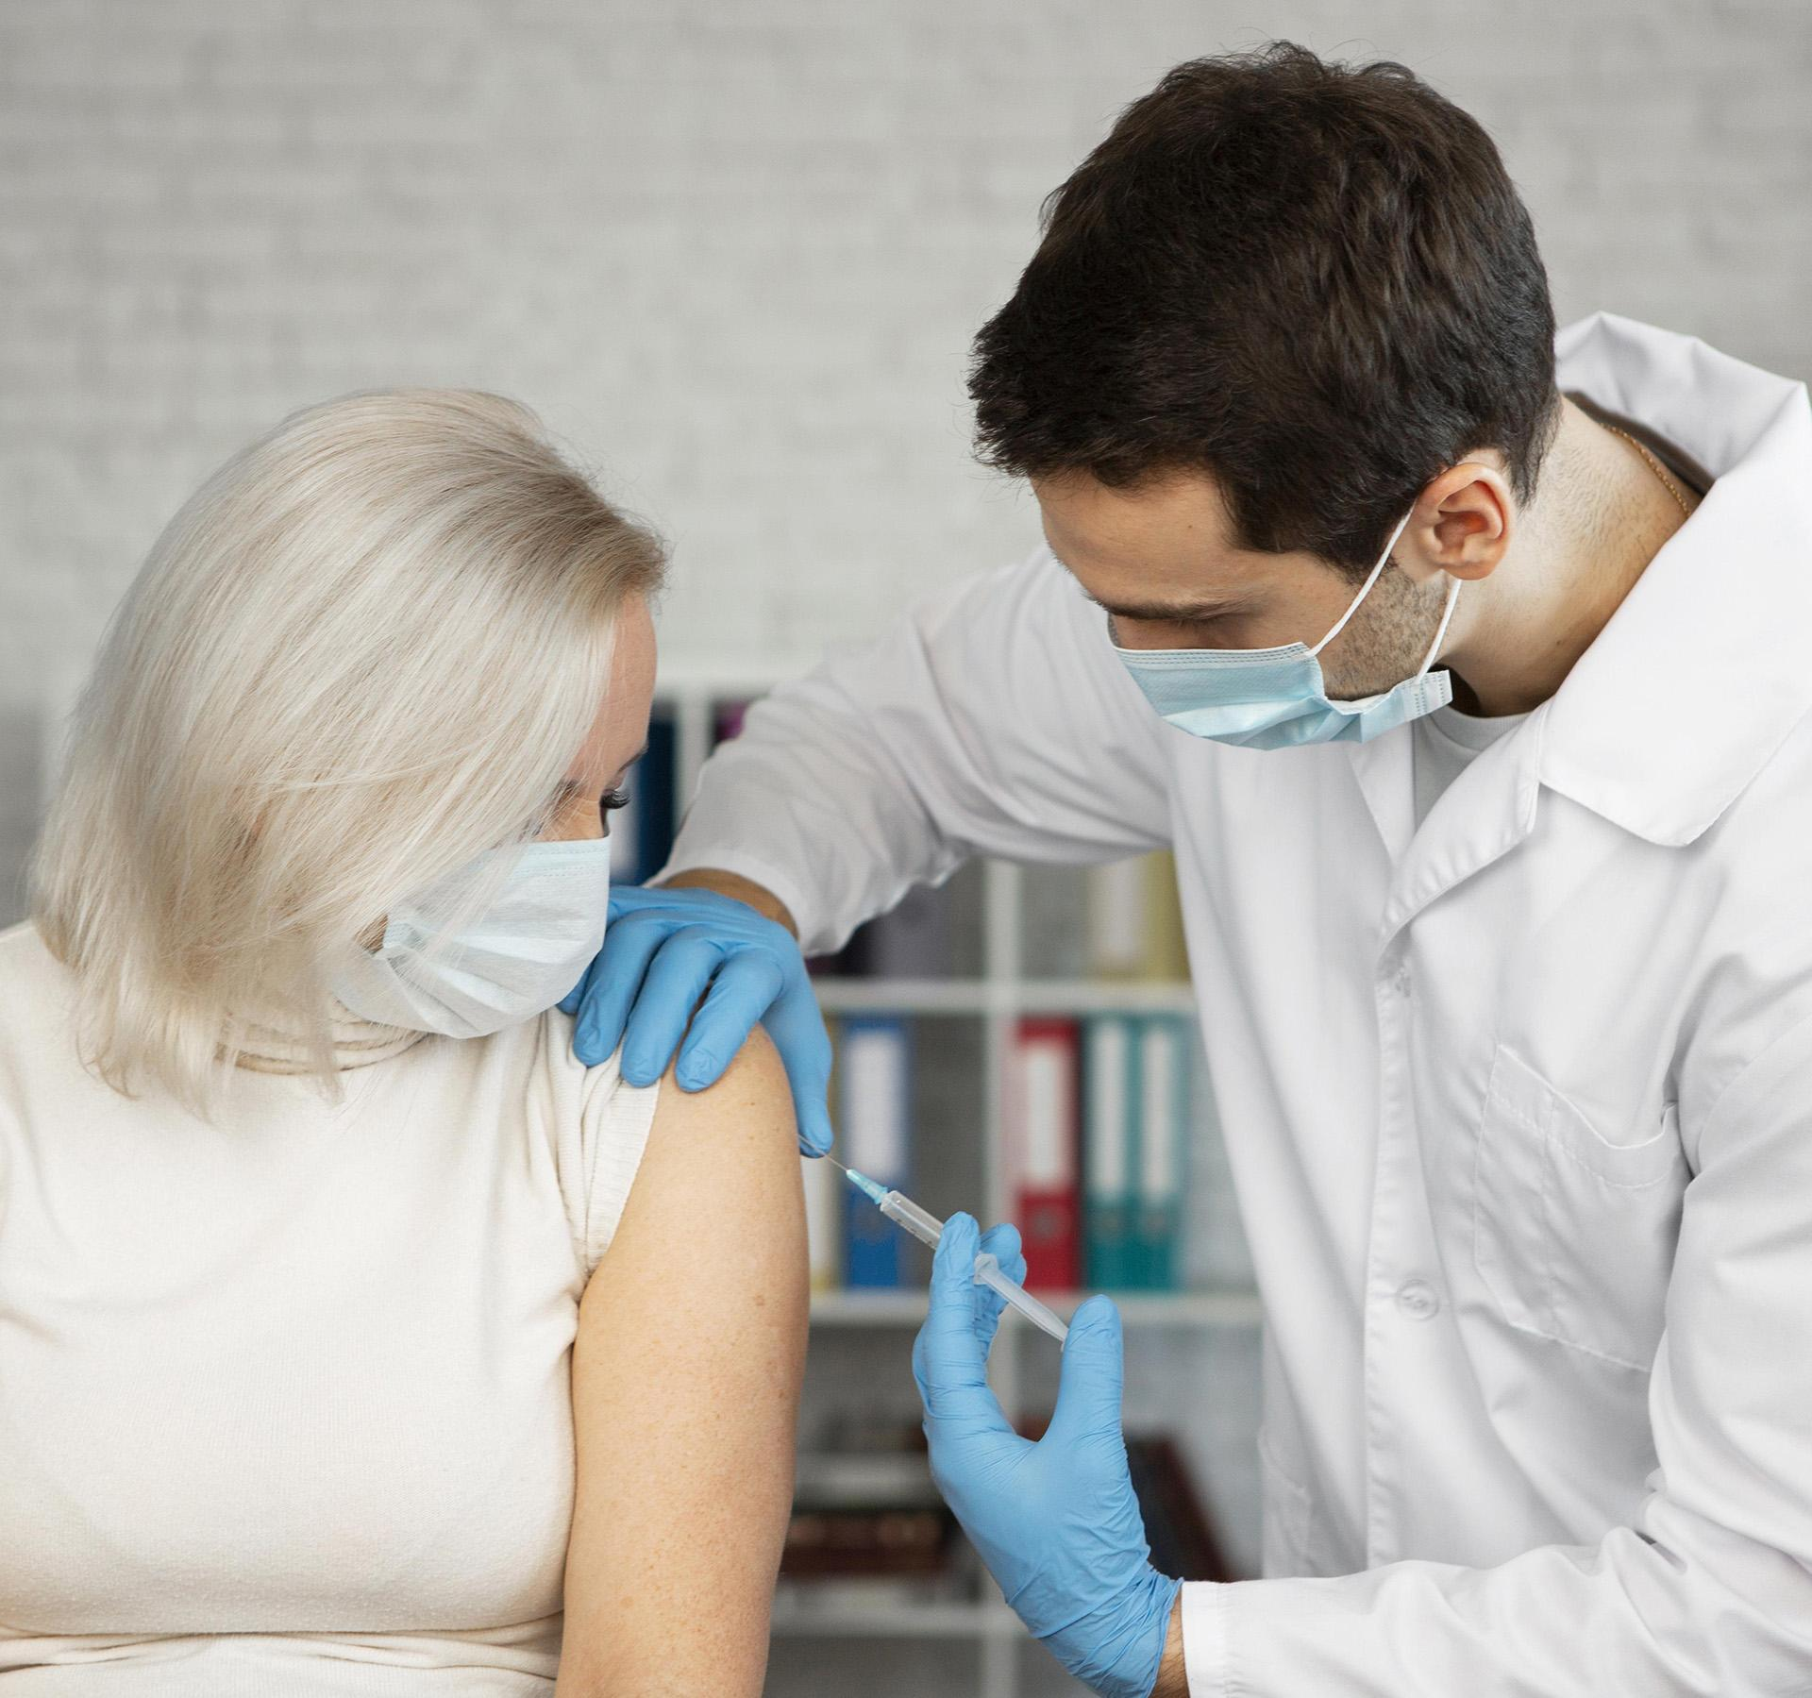
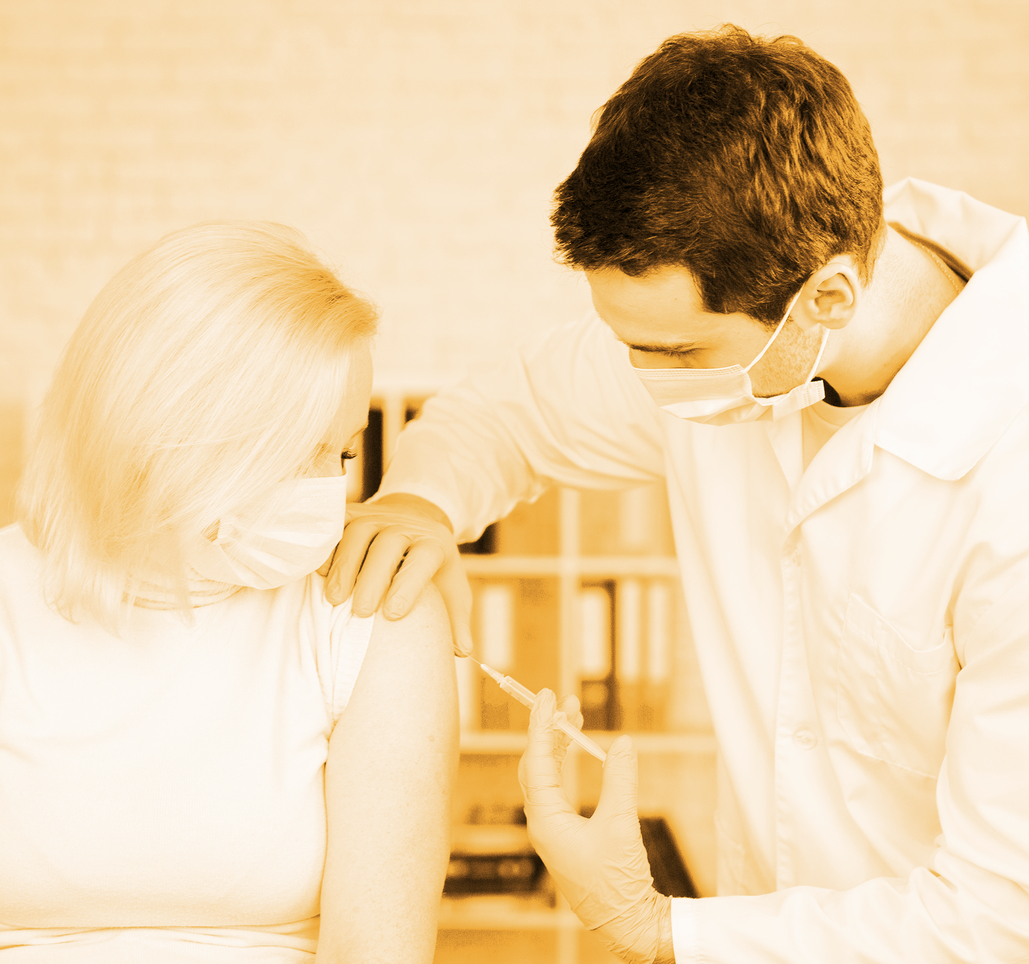
Problem statement
The outbreak of the COVID-19 pandemic has strained healthcare systems globally, necessitating efficient and accurate diagnostic tools to identify infected individuals.
Manual interpretation of chest X-rays for COVID-19 diagnosis is time-consuming and can be prone to human error, especially in high-volume settings.
To address this challenge, the development of automated systems utilizing deep learning techniques, particularly Convolutional Neural Networks (CNNs) is used.

Slide 5
Project overview
The Project aims to develop a CNN-based system for COVID-19 Detection using chest X-Rays.
Using the deep learning techniques we can detect whether a person has covid or not using their chest X-rays.
This makes the covid-19 detection process easier.

Slide 6
Who aRe the end users ?
Radiologists and Healthcare Professionals
Public Health Authorities
Hospitals and Healthcare Facilities
Researchers and Developers
Patients

Slide 7
the SOLUTION AND ITS VALUE PROPOSITION
The proposed solution involves developing a Convolutional Neural Network (CNN)-based model for automated detection of COVID-19 from chest X-ray images.
The CNN model will be trained on a dataset of labeled chest X-ray images, distinguishing between COVID-19 positive and COVID-19 negative cases.
The model will undergo rigorous validation and optimization to ensure high accuracy, sensitivity, and specificity in detecting COVID-19 pneumonia.

Slide 8
THE “WOW” IN SOLUTION
Accuracy and Reliability in detection of COVID-19
Public Health Impact
Scalability and Accessibility
Easy detection of COVID-19 by using only X-Rays of patients

Slide 9
Modeling :
Data Preparation:
Data Collection:
Gather a dataset of chest X-ray images containing both COVID-19 positive and negative cases. Ensure that the dataset is diverse and representative of the target population.
Data Preprocessing:
Preprocess the images to ensure they are of uniform size and quality. This may involve resizing, normalization, and augmentation techniques such as rotation, flipping, and zooming to increase the diversity of the dataset.
Data Splitting:
Split the dataset into training, validation, and testing sets. Typically, you might use 70-80% of the data for training, 10-15% for validation, and the remaining portion for testing. Ensure that the splits are stratified to maintain the class distribution in each subset.

Slide 10
Modeling :
Model Definition:
Define the architecture of your CNN model. CNN model is used for classication of X-Rays of patients.
Specify the input shape based on the dimensions of your input images.Appropriate activation functions, loss function, and optimization algorithm for training the model is chosen.
Model Training:
The model is compiled with the chosen optimizer, loss function, and evaluation metrics.
Model is trained on the training data using the fit() function. Monitor the model's performance on the validation set to detect overfitting.
Model Evaluation:
Evaluate the trained model on the test set using the evaluate() function. Calculate performance metrics such as accuracy, precision, recall, F1-score, and ROC-AUC to assess the model's performance.

Slide 11
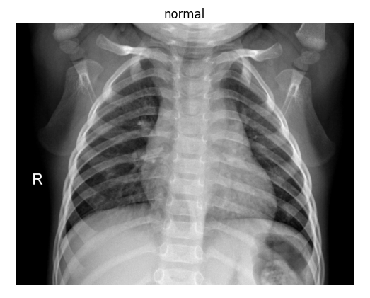
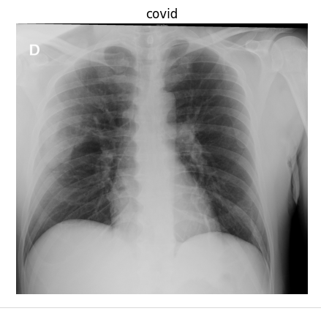
results:
Normal patient’s x-ray classified as normal
A Covid-19 patient’s x-ray classified as covid

Slide 12
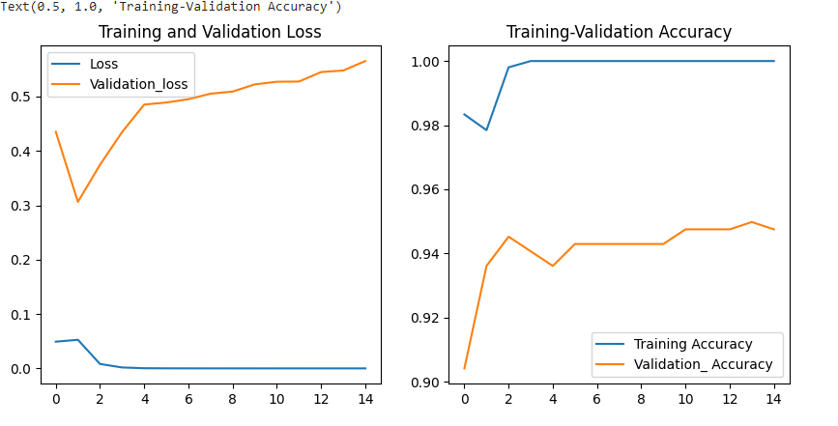
Model EVALUATION by visualisation :

Slide 13
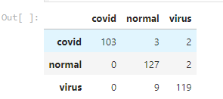
Evaluation :
The Model finally predicted the number of patients normal and the number of patients having COVID-19

Slide 14
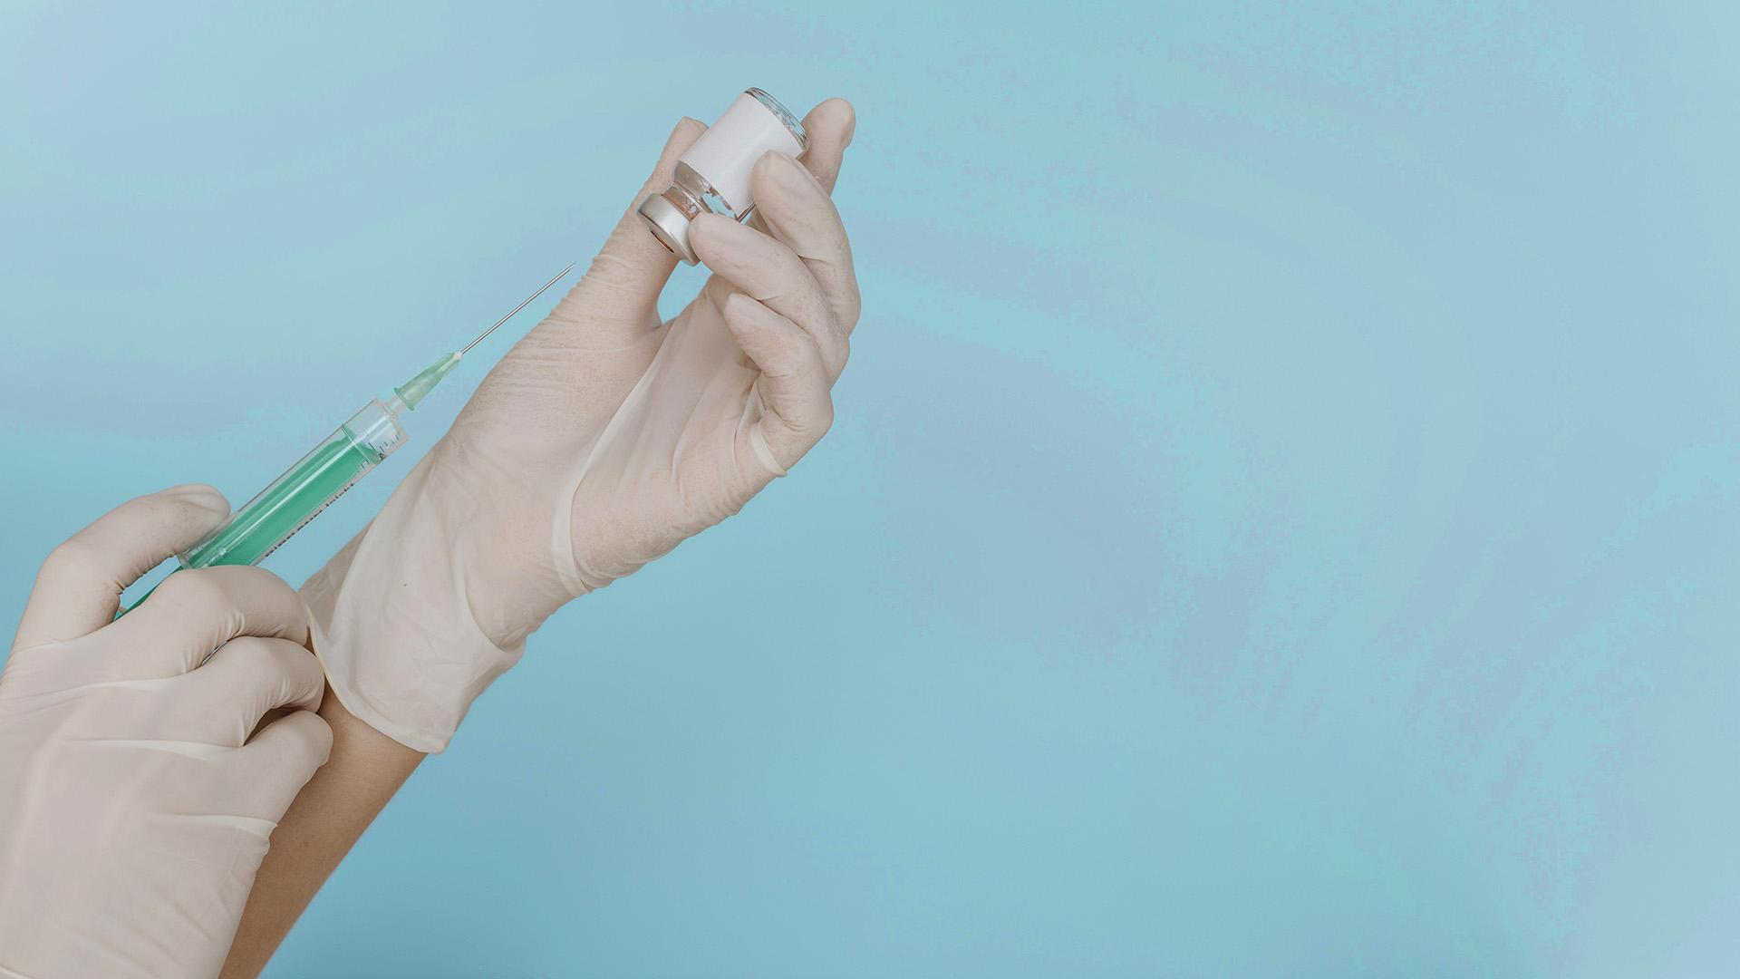

CONCLUSION
The model predicted the patient with covid-19 and a normal person by taking only their x-rays as input.
In conclusion, this project underscores the potential of deep learning techniques, particularly CNNs, in the realm of medical image analysis.
By leveraging advanced technologies, we can augment healthcare systems' capabilities to combat infectious diseases like COVID-19, ultimately contributing to better patient outcomes and public health.

Slide 15
THANK YOU

